Slide 1

JAVA vs Ruby comparison
Object-Oriented Programming
Universidad Amerike
Uri yael Álvarez López
José miguel atilano tlapaya

Slide 2

typing
Java: It is a static typing language. This means that the type of each variable must be declared before it can be used.
Ruby: It's a dynamic typing language. This means that the type of a variable does not need to be declared and can change during program execution.

Slide 3

Compilation
Java: It is a compiled language. This means that Java code is converted into machine code before it is executed.
Ruby: It's an interpreted language. This means that Ruby code is executed line by line by an interpreter.

Slide 4
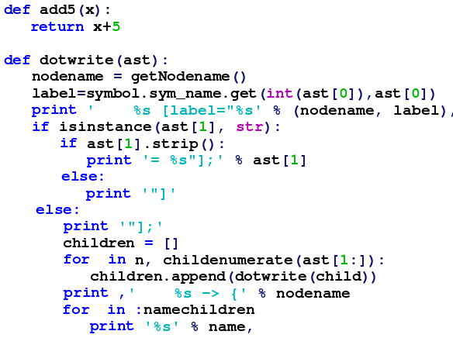
Syntax
Java: It has a syntax similar to C++. It's a relatively complex and verbose syntax.
Ruby: It has a very simple and elegant syntax. It's an easy language to learn and use.

Slide 5

Development Environment
Java: It has a wide ecosystem of tools and libraries available.
Ruby: It also has a good ecosystem of tools and libraries, although not as extensive as Java's.

Slide 6

performance
Java: It is a generally fast and efficient language.
Ruby: It can be less efficient than Java, especially for applications that require high performance.

Slide 7

Use
Java: Used to develop a wide variety of applications, including web applications, enterprise applications, and mobile applications.
Ruby: It is mainly used for web development, scripts.

Slide 8
Comparison Table
Característica | Java | Ruby
Tipado | Estático | Dinámico
Compilación | Compilado | Interpretado
Robustez | Robusto | Flexible
Complejidad | Complejo | Sencillo
Curva de aprendizaje | Pronunciada | Suave
Ideal para | Aplicaciones empresariales | Aplicaciones web, scripts

Slide 9
References
Tagline Infotech. (2023). Java vs. Ruby: The Ideal Programming Language in 2023. recuperado de https://taglineinfotech.com/ruby-vs-java/
Matsumoto, Y. (2023). A Ruby desde Java. Recuperado de https://www.ruby-lang.org/es/documentation/ruby-from-other-languages/to-ruby-from-java/
Dans, E. (2008). Java vs Ruby | Presión Blogosférica. Recuperado de http://www.presionblogosferica.com/2008/02/18/java-vs-ruby/

